Slide 1
The slides and icons are a collection of free templates available across different websites. Feel free to explore more templates on the web
1. SlidesGo
2. PresentationsGO
3. Slides24

Slide 2






















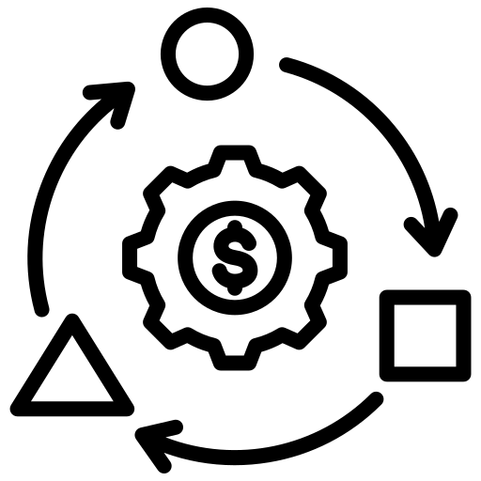







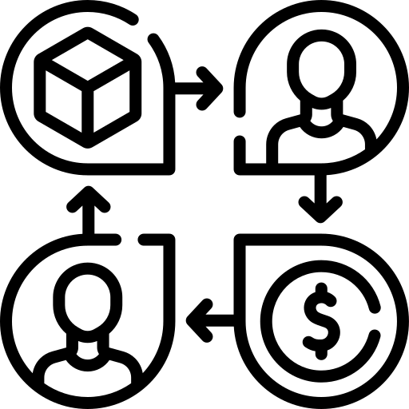















































































Slide 3


















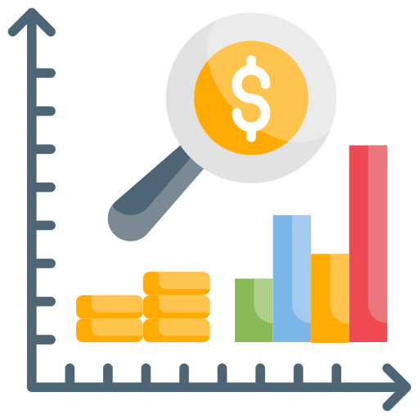
























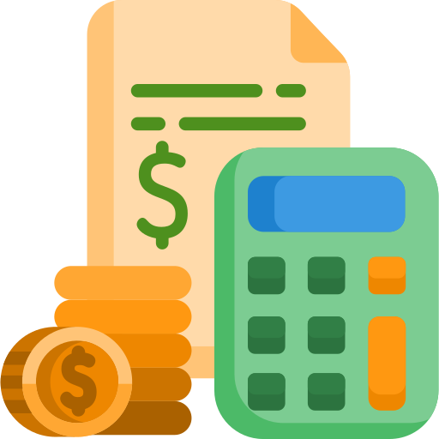




















Growth
Money
Time

Slide 4




































































Strategy & Operations
Data & AI
Checklist/Notes

Slide 5





























































People
Technology
Analytics

Slide 6















Free Icons Slide Template

Slide 7
BUSINESS ICON PACK

Slide 9
Icon pack

